Slide 1
Sub Queries
A Query is embedded in another Query is called “Sub-Query”
Sub Query consist two Queries, one Query called inner-Query and another Query is called Outer Query
In Sub Queries first inner query is executed then Outer Query
The result of inner Query act as input to Outer Query.

Slide 2
Sub Queries
Outer Query can be
Insert
Update
Delete
Select
Innter Query must be always Select
Syntax:
Select <collist> from <tablename> where colname operator(select statement)

Slide 3
Sub Queries
Types of Sub-Queries
Single row Sub-Query
If inner Query returns only one value, then the sub Query is called “Single Row Sub Query”
Op must be “>,<,>=,<=,=,<>”
Multiple Sub-Queries
If inner Query returns more than one value, then the Sub-Query is called “Multirow Sub-Queries”
Op must be in, not in,any,all,exist,not exist

Slide 4
Sub Queries
Display employee records whos deptid equal to deptid of david
Select * from employee where deptid=(select deptid from employee where ename=‘David’)
Display name of the Employee having max salary
Select ename from employee where sal=(select max(sal) from employee)
Display name of the employee having max experience.
Select ename from employee where hiredate=(select min(hiredate) from employee)

Slide 5
Sub Queries
Display employee records whos deptid is of smith or david
Select * from emp where deptid in(select deptid from employee where ename=‘david’ or ename=‘smith’

Slide 6
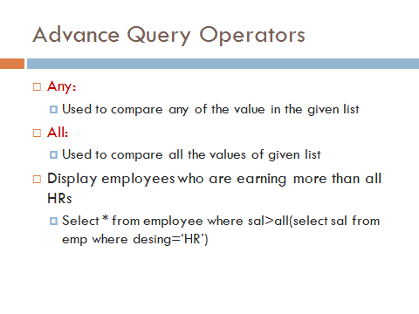

Slide 7
Sub Queries
Sub-Queries with Update Command:
Update the employee salary to max salary whose eno=1001
Update emp set sal=(select max(sal) from emp) where empno=1001
Update the employee salary to max salary of the IT dept whose eno=1001
Update emp set sal=(select max(sal) from emp where did=(select did from dept where dname=‘information tech’) where eno=1001
Sub-Queries with Delete Command:
Delete all employee records whose desig=desig of david
Delete from employee where desig=(select desig from emp where ename=‘david’)

Slide 8
Co-related Sub-Queries
In co-related sub-queries execution starts from outer query, for every record of outer query table inner query executed once.
In Co-related sub-queries inner query also takes value from outer query.
Ex: display names of the employees earning max salaries in their dept.
Select ename,sal,deptno from emp x where x.sal=(select max(sal) from emp where deptno=x.deptno)

Slide 9
Co-related Sub-Queries
In co-related sub-queries ,we can use 2 operators exists, Not exists
Exists, on exists returns true/false values
Exists returns true, if sub query returns at least one record other wise it returns false.
Exists checks whether record is present in the table or not.
Display department list which are not empty.
Select * from dept d where exists(select * from emp where deptno=d.deptno)
Display list of Managers
Select * from emp x where exists(select * from emp where mgr=x.empno)
Display department which are empty.
Select * from dept d where not exists(select * from emp where deptno=d.deptno)

